Slide 1
T-test!
(And writing functions in R)

Slide 2
Today
Basics of writing a function
What’s a student’s t-test?
A few examples of how and when to use t-tests
How beer and the t-test are related
Notes
I’m a social (political) scientist/pollster/what have you, not a computer scientist
(i.e. I can’t explain why this makes sense from that perspective, I can just show you how it works ☺ )

Slide 3
Functions!
By the way, what’s a function?

Slide 4
“To understand computations in R, two slogans are helpful:
• Everything that exists is an object. • Everything that happens is a function call."
— John Chambers (The person who came up with R)
Now, let’s write a few basic functions (we’ll get to the t-test)

Slide 5
T-tests!
What’s a t-test?

Slide 6
Its this
“A t-test is any statistical hypothesis test in which the test statistic follows a Student's t-distribution under the null hypothesis.”
(Yes, that’s copied and pasted from Wikipedia)
But what does that mean and how can I use it?

Slide 7
Inferential statistics
They basically answer the question, how do I know a difference is a difference?
Why does that question make sense?

Slide 8
Getting back to the t-test….
A t-test can tell us, if:
The outcome we are interested is normal
There are two groups we are interested in comparing

Slide 9
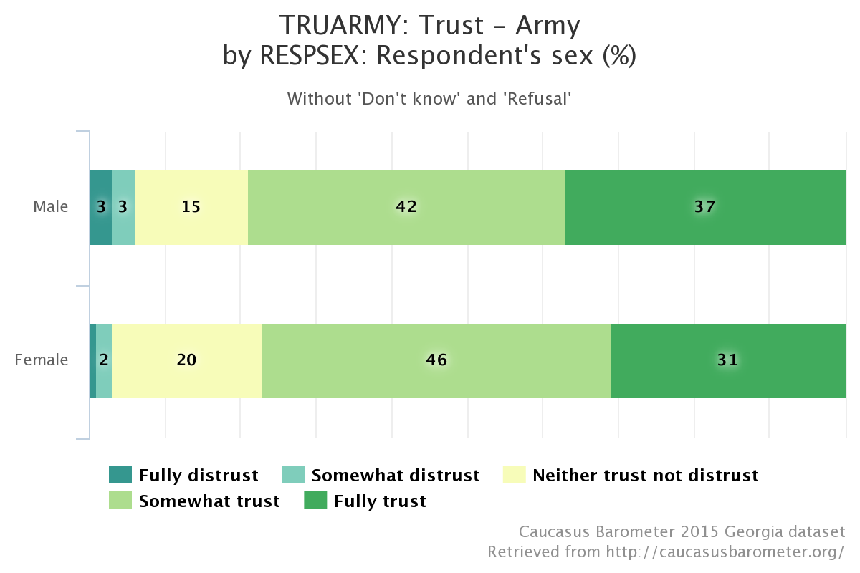
To give a practical example…are men more distrusting of the Army?

Slide 10
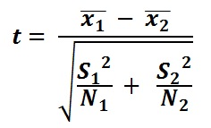
Here is the formula for a (independent samples) t-test
Xbarsub 1 is mean of variable for group 1
Xbarsub 2 is mean of variable for group 2
S=standard deviation
N= sample size
I’ll leave this formula up
and try to write the function
In R

Slide 11
So, are men more distrusting of the Army?

Slide 12
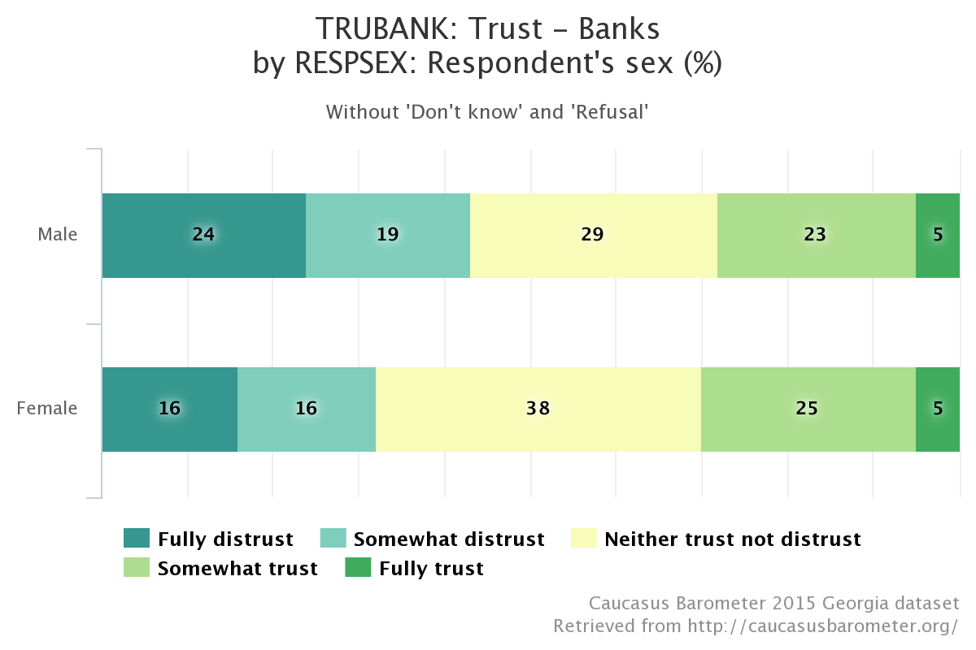
Do men distrust banks more than women?

Slide 13
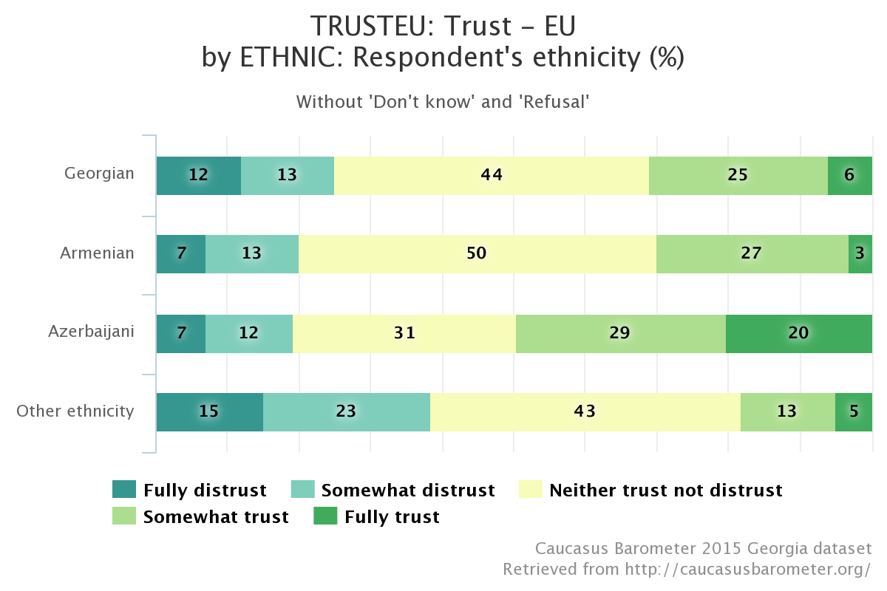
Do ethnic minorities distrust the EU more than ethnic Georgians?

Slide 14
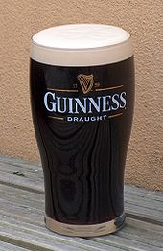
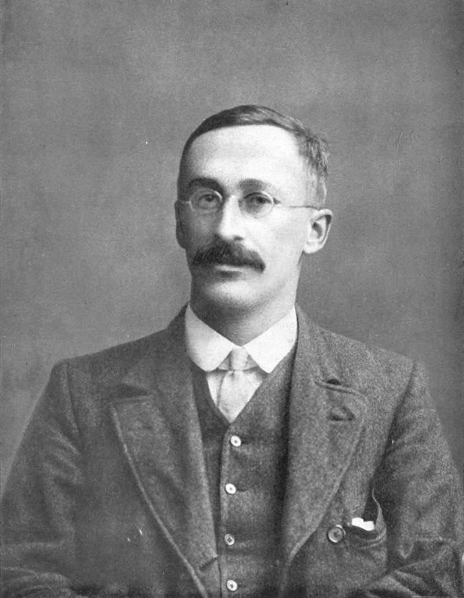
How beer led to statistical innovation
Student = William Gosset
He figured out you needed to take into account the
sample size
He did this in service of consistent beer quality ☺

Slide 15
Any questions?
(Thanks for listening ☺ )

